Slide 1

AIDE
AI Deployment Engineer Program
M3M3TIC LLC · 2026

Slide 2
The AI Opportunity
$104B
73%
of SMBs cite data privacy as their #1 concern with AI adoption
Projected AI market by 2034
$0
Bonfire's recurring cost after installation

Slide 3
The Problem
01
Cloud AI is expensive
Recurring SaaS fees drain SMB budgets
02
Cloud AI is insecure
Sensitive data leaves your network
03
Cloud AI is dependent
No internet = no AI
04
Cloud AI is inaccessible
Non-English speakers are left behind
05
Nobody is solving this
No turnkey local AI deployment exists

Slide 4
The Bonfire Solution
Local AI that works offline, stays private, and speaks every language.
⚡ Offline
🔒 Private
🌍 Polyglot
Runs 100% on local hardware. No cloud. No latency. No outages.
Data never leaves the building. Full compliance. Zero exposure.
50+ languages out of the box. Serve any community, anywhere.

Slide 5
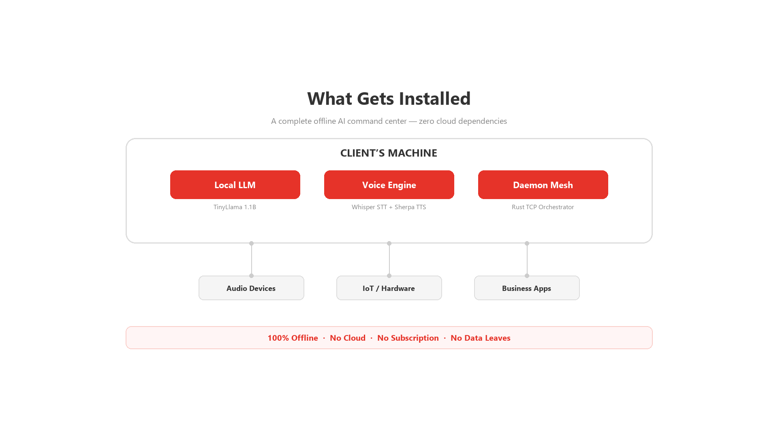
What Gets Installed

Slide 6
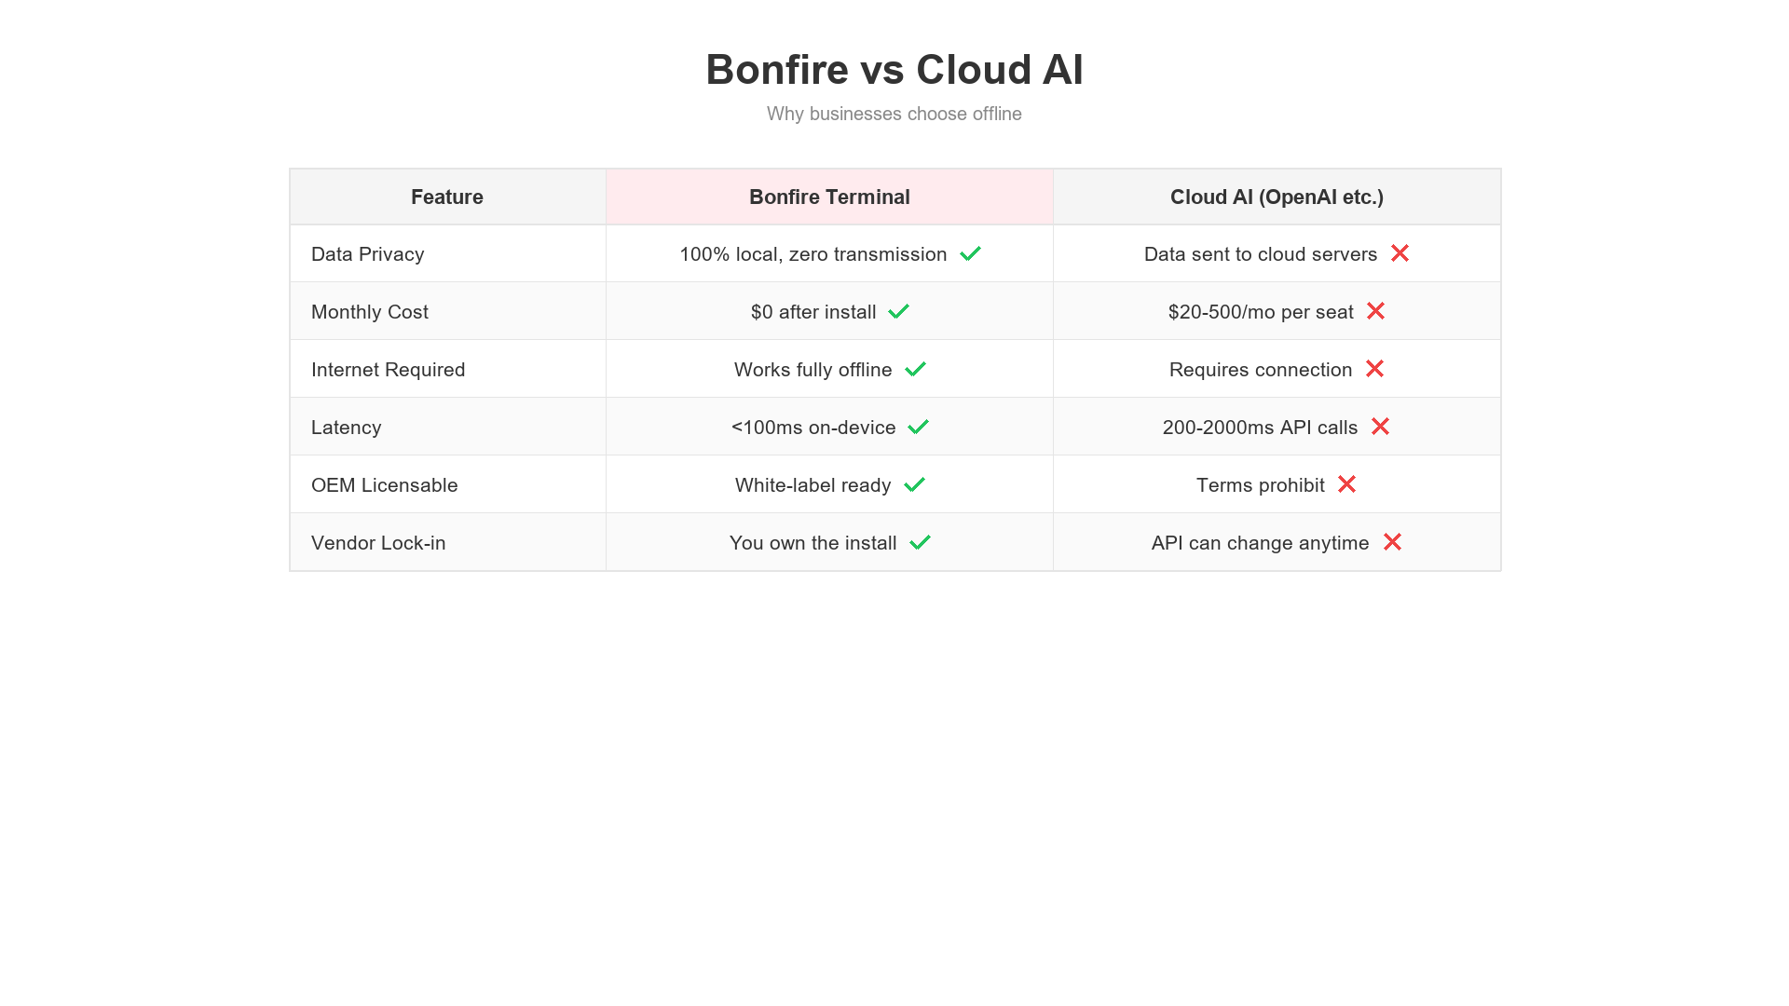
Bonfire vs Cloud AI

Slide 7
The Franchise Model
Same model. Different industry.
Proven System
Training
Brand Support
Pre-configured stack with deployment scripts
16 sessions: 6 product + 10 certification
Bonfire brand assets, AI Marketers Club access

Slide 8
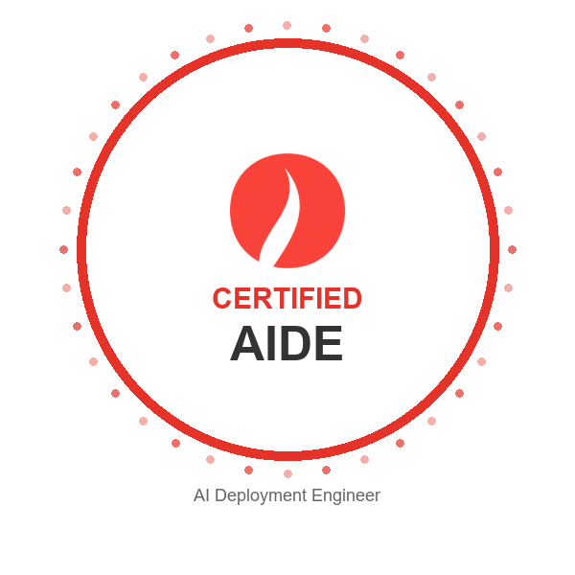
What is an AIDE?
AI Deployment Engineer
A certified professional who deploys, configures, and supports Bonfire systems.
▸
Certified through hands-on training
▸
Authorized to sell & deploy Bonfire
▸
Ongoing technical support access
▸
White-label & reseller rights included

Slide 9
Your 3-Step Path
1
2
3
GET CERTIFIED
DEPLOY
EARN
Complete training & earn your AIDE badge
Install Bonfire for local businesses
Build recurring revenue from your clients

Slide 10
The AIDE Certification Package
$18,000
One-time investment. Lifetime returns.
▸
Pre-configured Bonfire server hardware
▸
Deployment scripts & automation
▸
Complete software license & stack
▸
Priority technical support (1 year)
▸
Hands-on certification training
▸
AI Marketers Club + weekly webinars
▸
Marketing & sales toolkit
▸
Revenue share on renewals

Slide 11
Revenue Model
Two paths. Stack them for maximum income.
White-Label
Reseller / Affiliate
Keep 100% of install fee
20% commission
$8,000 avg
$1,600 per $8K referral
2 white-label ($16K) + 1 referral ($1.6K) = $17,600/mo

Slide 12
Training & Support
Certification
AI Marketers Club
Marketing Kit
16 Total 1-on-1 Sessions 6 Bonfire Training + 10 Certification
Weekly webinars in John Crestani's community. Peer support & deal pipeline sharing.
Branded collateral, pitch decks, demo scripts, and lead generation playbook

Slide 13
Use Cases: Main Street Verticals
Coaches
Marketing Agencies
Realtors
Lawyers
AI-powered client plans & follow-ups
Private campaign analytics & copy
Local MLS insights & client comms
Confidential legal research & drafting
Accountants
Dentists
Plastic Surgeons
Chiropractors
Private financial analysis & reporting
Patient records & scheduling AI
HIPAA-compliant consult notes
Treatment plans & patient intake
Insurance Agents
Financial Advisors
Fitness Studios
Med Spas
Policy comparison & quoting AI
Portfolio analysis & client reports
Member engagement & programming
Booking, consults & treatment tracking

Slide 14
Hardware & IoT Embedding
Your AIDE license also permits embedding Bonfire Terminal
into hardware and IoT devices.
Ask your sales representative for details.

Slide 15
What AIDEs Are Saying
“
“
“
“I deployed 3 systems in my first week. The demand is unreal.”
“Clients love that their data stays on-site. It sells itself.”
“The training was thorough. I felt ready to deploy day one.”
— AIDE #012, Dallas TX
— AIDE #008, Miami FL
— AIDE #015, Portland OR

Slide 16
Frequently Asked Questions
Do I need technical experience?
No. Our 16-session 1-on-1 training covers everything from hardware setup to client deployment.
What hardware is included?
A pre-configured AI server with GPU, all cabling, and deployment toolkit.
How do I find clients?
We provide lead generation tools, marketing collateral, and the AI Marketers Club community.
Is there ongoing support?
Yes. Weekly webinars in the AI Marketers Club, priority support, and remote troubleshooting.
What’s the ROI timeline?
Most AIDEs break even within 2–3 deployments — typically in the first month.

Slide 17
Apply Now
Become a Certified AI Deployment Engineer
bonfireterminal.com

